Slide 1
Human Trafficking In Western Europe
Student Name
Institution Affiliation

Slide 2
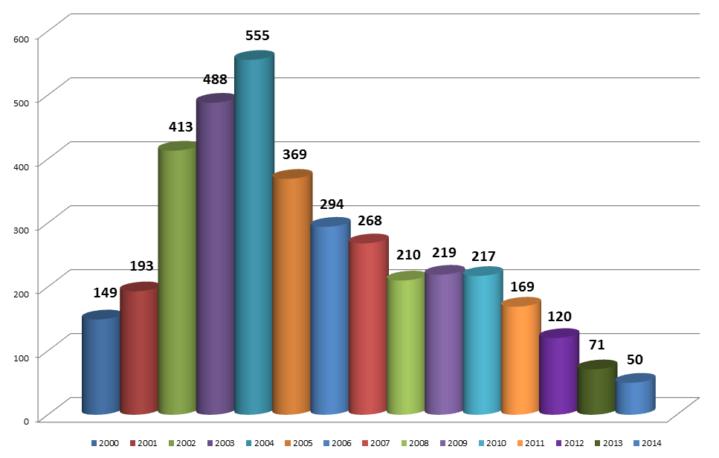
Overview of the Presentation
Understanding the concept of Human Trafficking
Identifying the route cause of human trafficking in Western Europe
Identifying the prevalence of Human Trafficking in western Europe
The Recruitment basis of Victims of human trafficking in Western Europe
Why human trafficking has narrowed down to Child trafficking
Identification of the challenges that most ant-traffickers face
Defining the role of NFGOs in combating human trafficking in western Europe
Notes:
I want to start the presentation by asking you questions; how would you feel if your child, brother/sister, relative or even friend is trafficked for any form of coercive exploitation. Human trafficking in western Europe is a regional phenomenon of the wider trade practice in human for the different purposes of coercive exploitation. Human trafficking has been a severe issue for the past years in western Europe. It precisely followed the slave trade which differs from human trafficking since the slave trade was legally accepted and recognized then. In the entire paper, I will focus focuses on the broad understanding of human trafficking in western Europe including the causes, prevalence, recruitment of victims, child trafficking, anti-trafficking effacers made and the role of NGOs in combating human trafficking (Baarda, 2016).

Slide 3
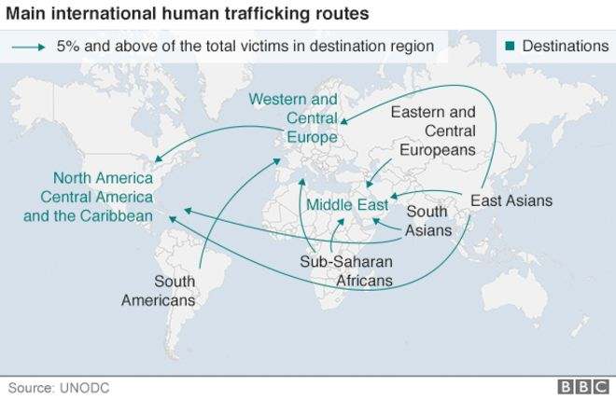
Definition of Human trafficking and How it arises in Western Europe
Human trafficking is a form of modem slavery.
Commercial Sex and labor purposes are the major why humans are trafficked
Coercion, Force, and Fraud methods are used by traffickers to achieve exploration.
Since the fall of Communism, human trafficking has been a concern in Western Europe countries.
Economic promises and hardships has left many individuals in western Europe vulnerable to trafficking.
Notes:
Human trafficking is a violation of human rights and takes place internationally. Most traffickers usually use coercion, force or fraud to enslave the victims into different situations including those involving forced labor and sexual exploitation. After the fall of communism in the 1990s, human trafficking has been an increasing issue I the various nations around western Europe. There has been created an opportunity for loss of citizen security in many of the countries due to market economy transitions (Petrunov, 2011).

Slide 4
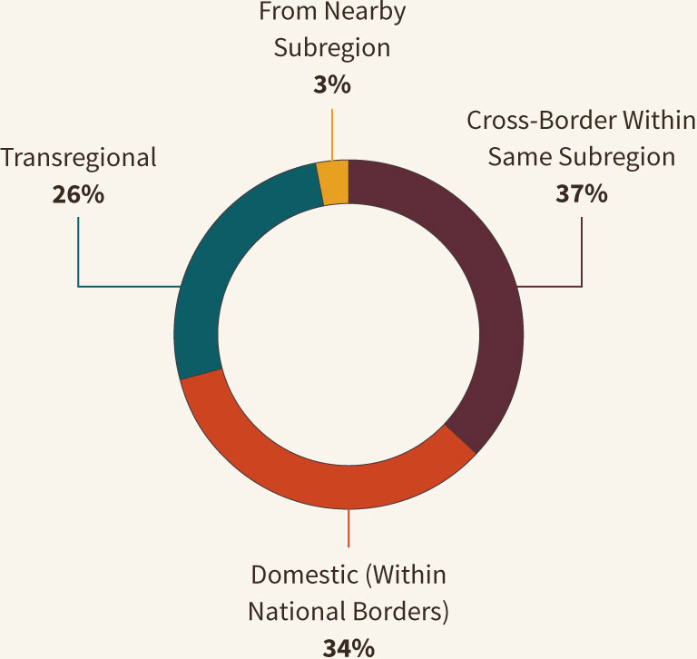
Causes of Human Trafficking in Western Europe
Collapsing of the Soviet Union is the main contributing factor to increased human trafficking
Close proximity and porous borders have made it easy for transportation of victim from the region to withier countries
War and Militarization in Balkans has also contributed to human trafficking in some western Europe countries.
Notes:
The collapsing of the Union of Soviet Socialists republic which is commonly referred to as the Soviet Union in 1991 is the primary cause of the increasing human trafficking in western Europe. It made provisions of both new regional opportunities and also human capital that was aimed at fueling the expansion. After its failure, trafficking victims were quickly captured, and due to the proximity of the regions they were captured from to the wealthier cuties, transportation was more comfortable. Many saw it as a cheap business that was much profitable to them hence engaging in human trafficking also. Additionally, war and militarization in the Balkans is also a major contributing factor to human trafficking in isomer of the western Europe nations. Thousands of women were trafficked for commercial sex exploitation after the war due to the availability of a large number of foreign men in specific countries (Breuil, et al., 2011).

Slide 5
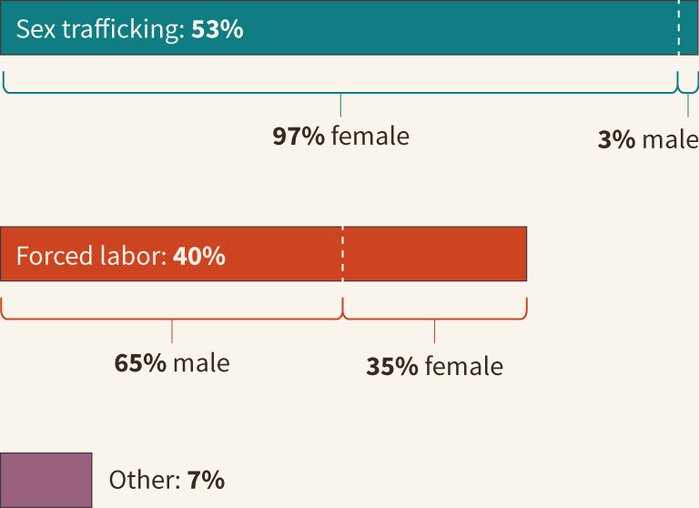
The Prevalence of Human Trafficking in Western Europe
Sex trafficking has received most attention in western Europe
Existence of transitional society majorly accelerated the trade of human beings.
Notes:
With the existence of all forms of human trafficking in western Europe, sex trafficking remains to be the leading type of human trafficking in the region where the media has highly publicized the exploitation of women and girls. More than half of the victims of human trafficking that have been assisted for the previous years have been victims of sexual exploitation. An ideal condition for trading human beings was created by the conditions of the existence of the transitional societies in most of the countries in western Europe. Just immediately after the initial transitional, all the forms of human trafficking became an epidemic in the region hence resulting in rising in criminal entrepreneurship, the frequent collision of the government official in this trade, ineffective countermeasures and also instances of poverty (Mordeson, Mathew, & Malik, 2018).

Slide 6
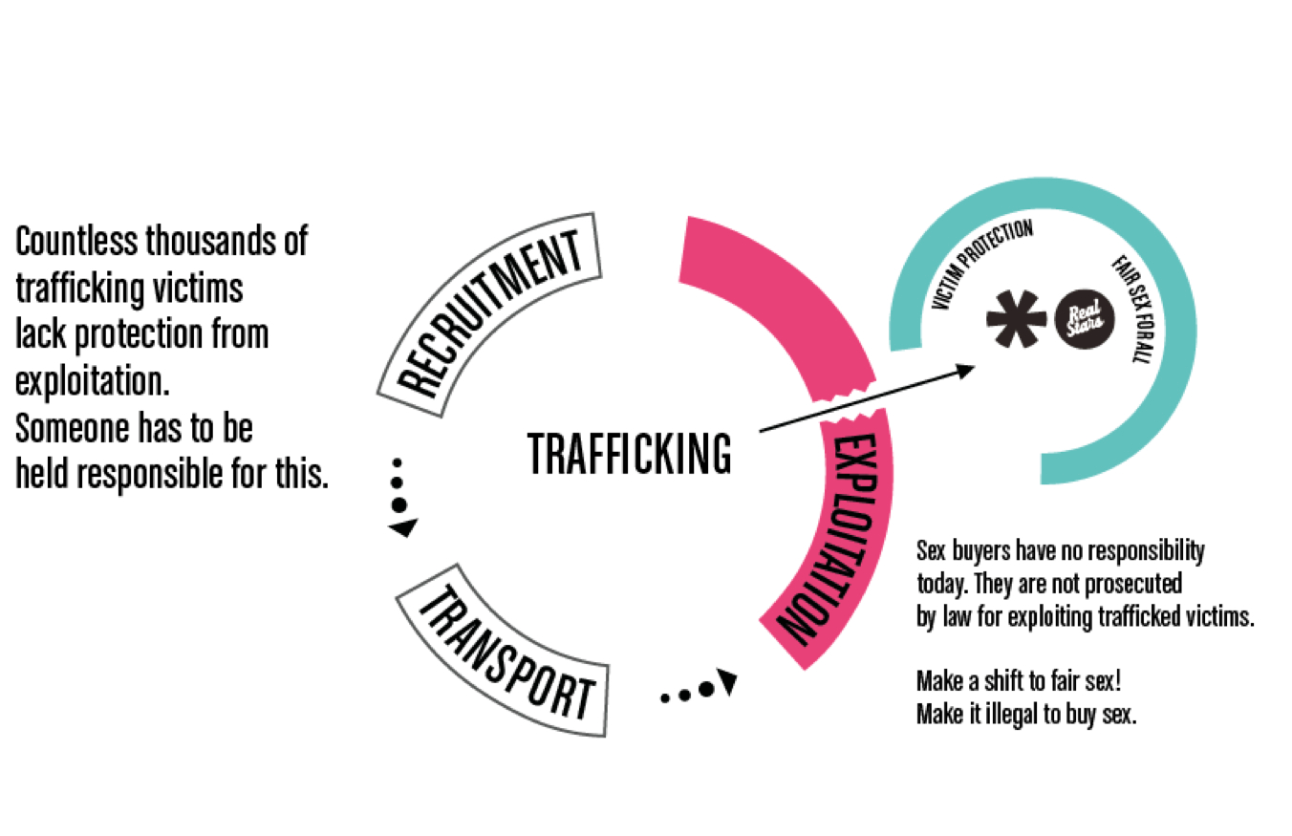
The Recruitment Basis of Victims of Human Trafficking in Western Europe
Ability to utilize advanced technology and personal connections.
Trafficked victims advanced education
Seek of better opportunities of employment abroad by most of the affected victims
Work and study opportunities, films production studios, fake modelling agencies, and employment and marriage agencies are some of the ways that have been used to capturer more educated victims.
Notes:
Many of the trafficked victims are highly educated. Human traffickers have been able to use their education to lure them to human trafficking. They majorly use the technology (internet) and personal connections to get the educated victims. Most of the educated individual despite having the chances to seek jobs in their countries, they try to find better jobs with better pay abroad hence falling in the trap of traffickers. Traffickers also use modern ways that attract many such as film production studio and fake modeling agencies to get more individuals to traffic (Baarda, 2016).

Slide 7
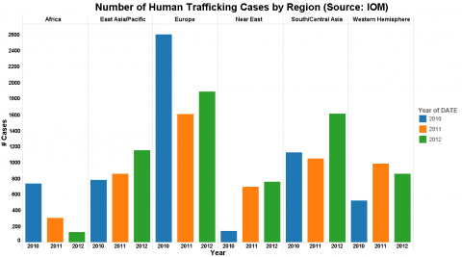
Child Trafficking
The following groups of children are at risk for trafficking in western Europe
Previously trafficked children
Children from ethnic minorities
School drop outs
Those lacking family protection and support
Those who suffer from domestic violence.
Notes:
The rate of child trafficking in western Europe has been high for several years. Some parents even started generating capital by trading their children. There are main five categories of children who are always targeted for trafficking. First, any child who had been previously trafficked then rescued has higher probabilities of being trafficked again. Those from minority ethnic groups in the region also are target victims. Children who drop out of schools become desperate looking for something to do hence can be easily trafficked. Most of the children living in institutions lack family protection and support thus choose to move to the institutions' such children are also high targets of the traffickers. Lastly, those children who face domestic violence in their homes also stand at a higher probability of being trafficked (Breuil, Siegel, Van Reenen, Beijer & Roos, 2011).

Slide 8
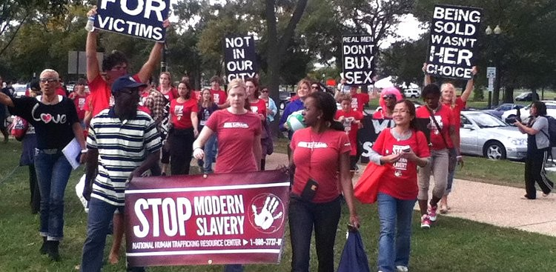
Challenges faced by Anti-Traffickers
Human trafficking data collection and management has always been the challenge due to the following reasons
Disparities in the number of crimes committed and those noticed.
Lack cooperation between the variety of actors
Government and NGOs mistrust.
Victim underreports occurrences due to cultural , linguistic etc. barriers
Misquotation of trafficking incidences during investigation
Lesser charges continue being classified as trafficking incidences due to miss-classification during investigation
Notes:
Anti-trafficking campaigns have been ineffective due to the challenge of data collection and management. Only data collected can be used in shaping the anti-trafficking policies. First, data collection is challenged by the fact that most of the crimes that are identified, investigated and prosecuted are different from those committed. Secondly, various actor such as agencies and organizations do not cooperate to collect in-depth crime data. The lack of cooperation is further reinforced by the fact that the Government and the NGOs distrust each other hence walking of different paths. Additionally, some victims do not report since inter-personal, cultural or linguistic barriers bind them. Lastly, there are some incidences of trafficking that cannot be well identified due to misclassification (Mordeson, Mathew, & Malik, 2018).

Slide 9
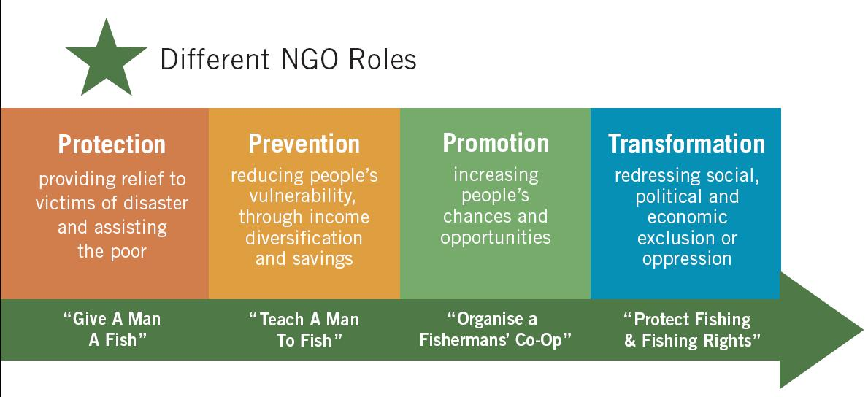
The Role of NGOs in Combating Human Trafficking
Lobbying for victims rights
Research and statistical and informal support
Awareness and educating about risk of trafficking
Reintegration, psychological counselling, social and legal support.
Notes:
Most of the NGOs despite lack of government support, broad mandates and lack of funding, they have come in to help in combating human trafficking in western Europe. Most of the victims trust NGOs since they believe that most of the traffickers fear NGOs but can cooperate with some authorities. Therefore NGOs help lobby for the victims' rights, offer research support, create human trafficking awareness to all citizens, and also help the victims psychologically, socially and even legally (Petrunov, 2011).

Slide 10
References
Baarda, C. S. (2016). Human trafficking for sexual exploitation from Nigeria into Western Europe: The role of voodoo rituals in the functioning of a criminal network. European Journal of Criminology, 13(2), 257-273.
Breuil, B. C. O., Siegel, D., Van Reenen, P., Beijer, A., & Roos, L. (2011). Human trafficking revisited: legal, enforcement and ethnographic narratives on sex trafficking to Western Europe. Trends in Organized Crime, 14(1), 30-46.
Mordeson, J. N., Mathew, S., & Malik, D. S. (2018). Human trafficking: Source, transit, destination designations. In Fuzzy Graph Theory with Applications to Human Trafficking (pp. 181-208). Springer, Cham.
Petrunov, G. (2011). Managing money acquired from human trafficking: case study of sex trafficking from Bulgaria to Western Europe. Trends in Organized Crime, 14(2-3), 165-183.

